Slide 1
Styles of communication
Prepared by
Dr. T. Sunand Emmanuel
Assistant Professor, H&SS Department

Slide 2
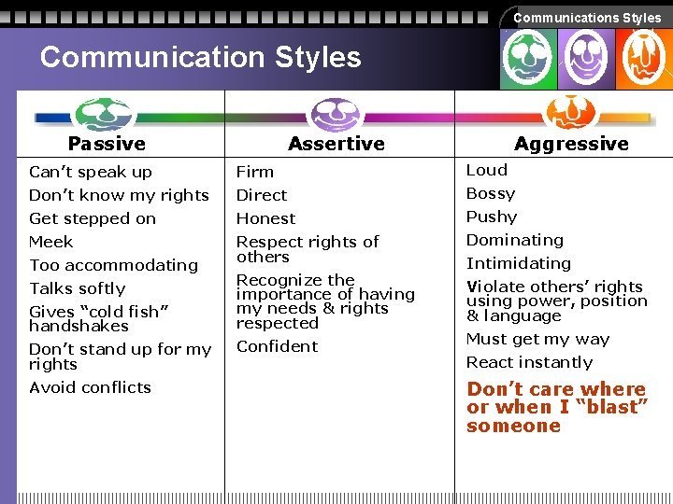

Slide 3
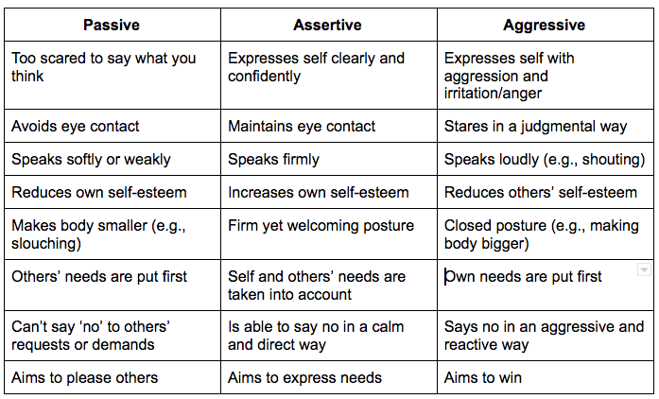

Slide 4
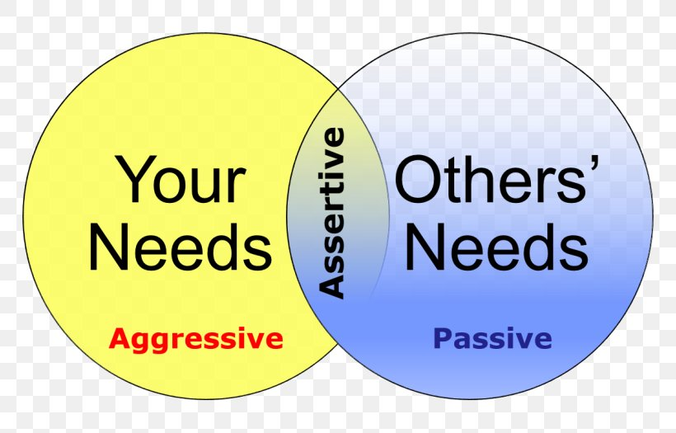

Slide 5
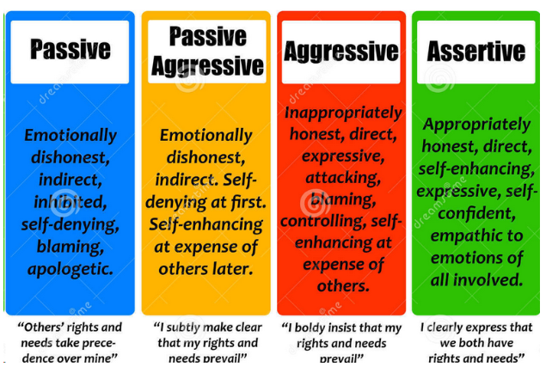

Slide 6
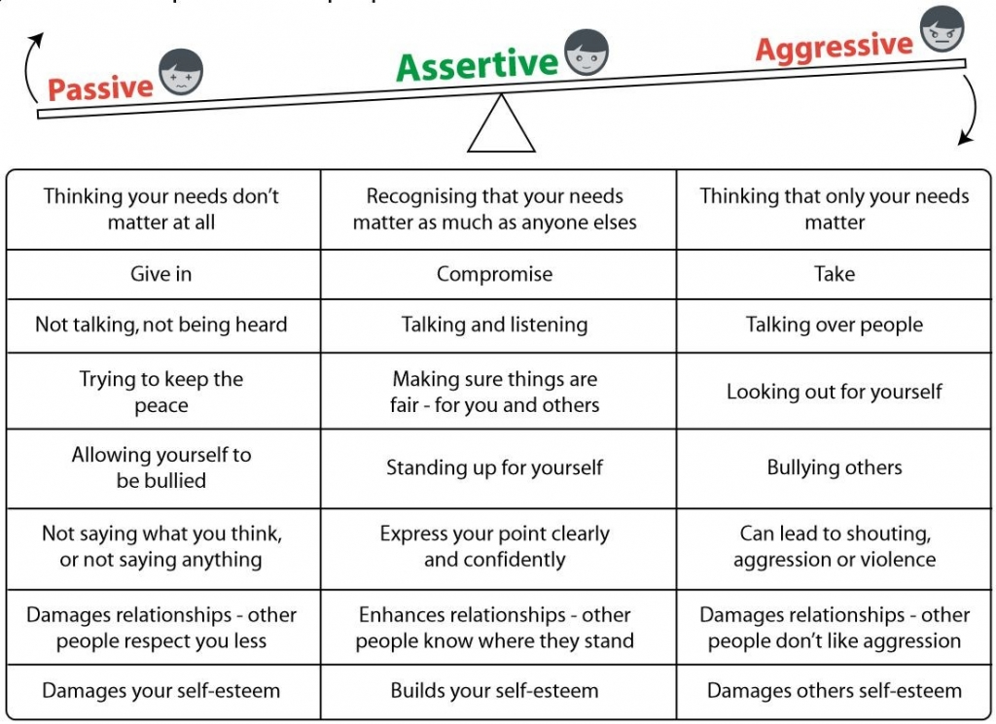

Slide 7
Styles of communication
Passive style: Surrender, self-pity. I can never be happy. I lose-you win.
Assertive style: I respect your views. But please listen to my views too. I win—you win.
Aggressive style: I don’t have to listen to you.
I win—you lose.
Passive-aggressive: I lose-you lose. Pretending to obey, but no. Non-cooperation.

Slide 8
References
https://www.google.com/search?q=passive+a
https://www.google.com/search?q=passive+a

